Slide 1
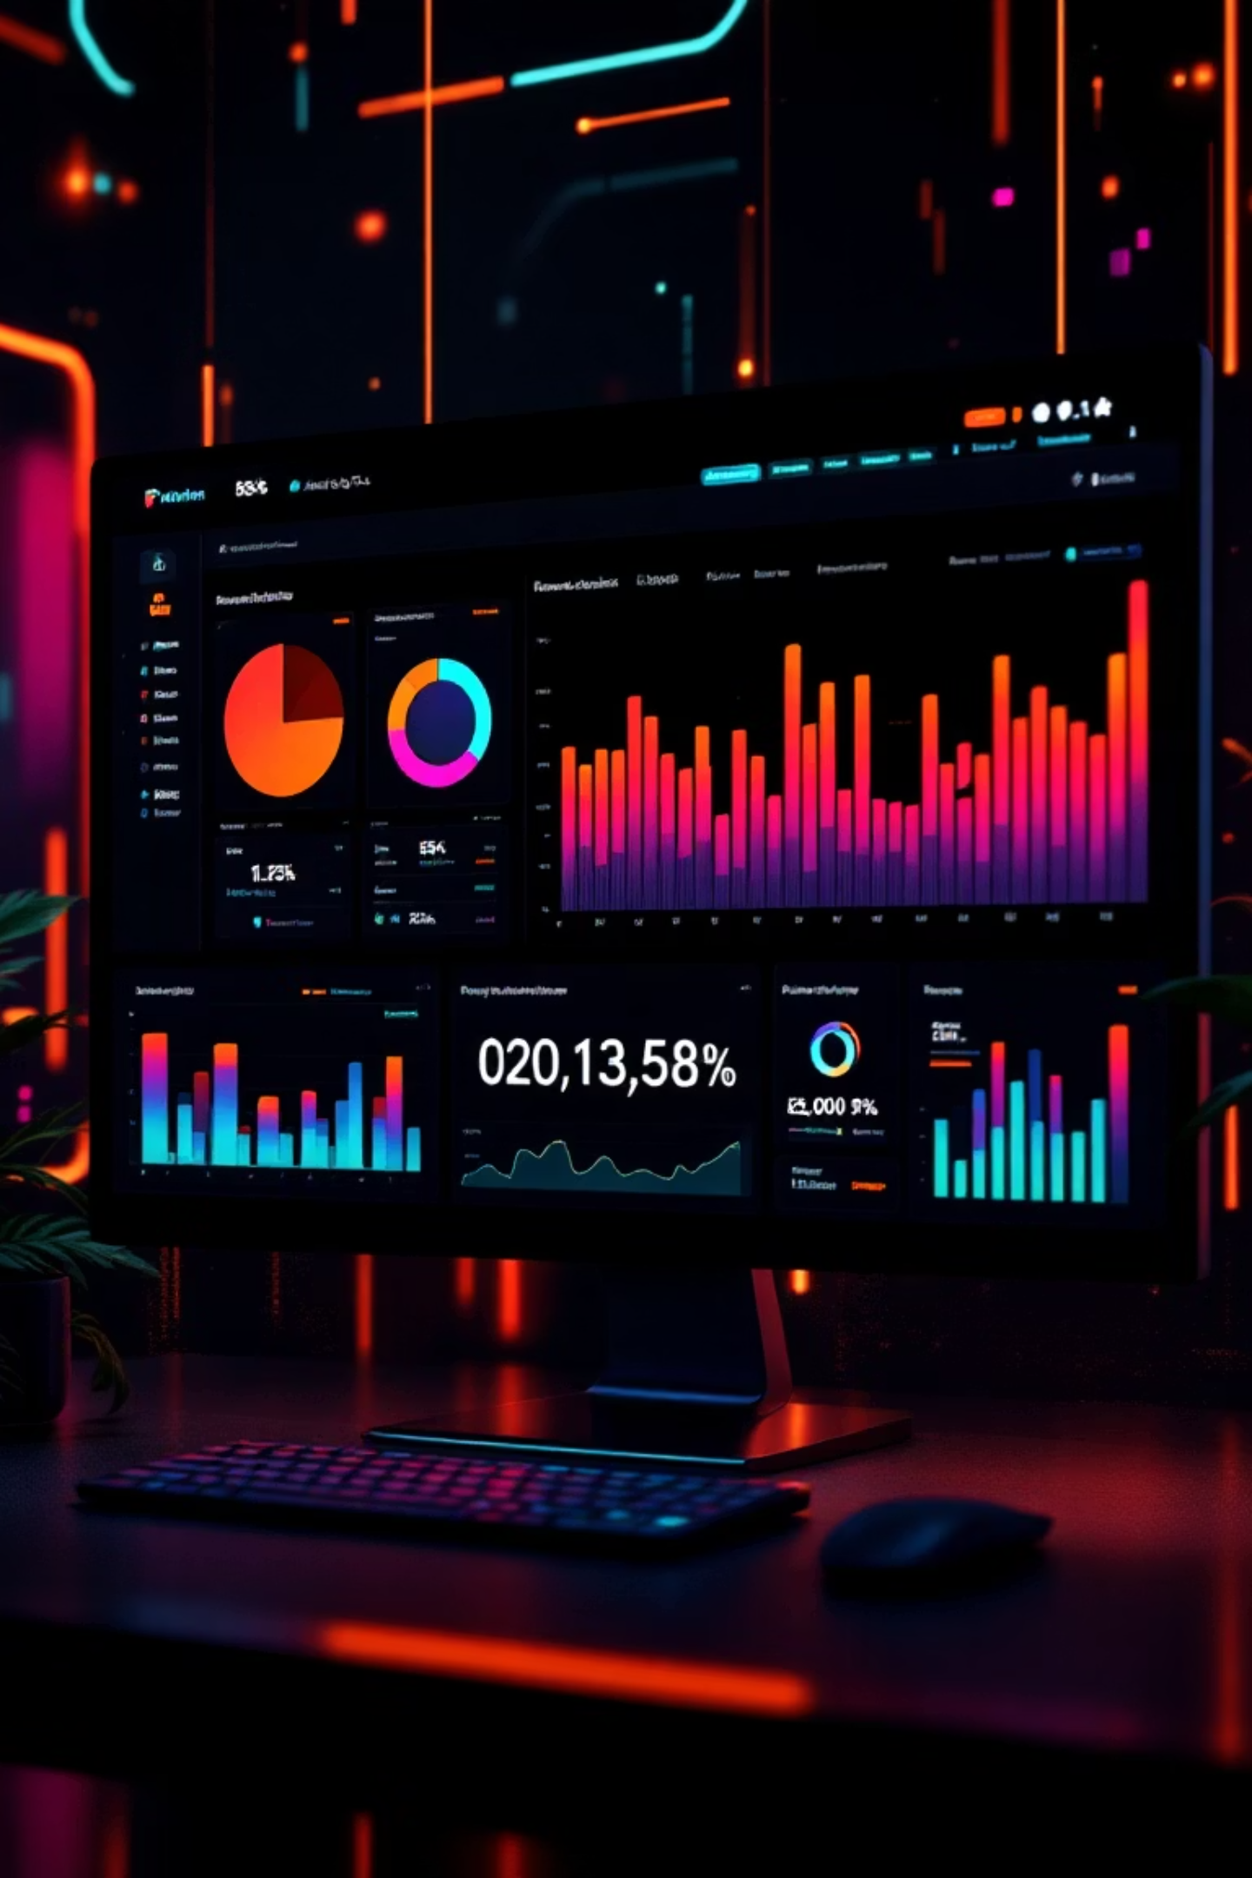
Retail Customer Analytics Project
An end-to-end analytics solution combining Pandas, SQL, and Power BI to transform raw retail data into actionable business insights.

Slide 2




Project Workflow
Data Cleaning
Pandas handles loading, cleaning, and feature engineering
Structured Analysis
MySQL stores cleaned data for efficient querying
Visualization
Power BI creates interactive dashboards

Slide 3

Data Cleaning with Pandas
Real-world datasets contain missing values, inconsistent naming, and redundant information. Pandas provided the flexibility to standardize and validate the dataset.
df.isnull().sum()
df["review_rating"] =
df.groupby("category")
["review_rating"]
.transform("median")
df.columns =
df.columns.str.lower()
.str.replace(" ", "_")
Key Cleaning Steps
Category-wise median values filled missing review ratings
Column names standardized to lowercase with underscores
Redundant columns removed through validation checks

Slide 4

Feature Engineering
Age Segmentation
Validation Checks
Analysis-Ready
Customers grouped into quartile-based age segments: young adults, adults, middle-aged, and senior
Final validation performed to ensure correctness before database storage
Dataset prepared for structured querying and visualization
labels = ["young adults", "adults", "middle-aged", "senior"]
df["age_group"] = pd.qcut(df["age"], q=4, labels=labels)

Slide 5

SQL Analysis
MySQL enabled structured querying, aggregation, and comparison to answer key business questions. SQL focused on data analysis, not cleaning.
01
02
Aggregation Functions
GROUP BY Analysis
AVG, SUM, and COUNT calculated key metrics
Performance analyzed by category and age group
03
Business Insights
Customer behavior and purchase trends identified

Slide 6
SQL Query Examples
Top 5 Items by Discount Rate
Customer Segmentation
Hat leads with 50% discount application, followed by Sneakers at 49.7%
Loyal customers dominate with 3,116 members
Segment
Count
Item
Discount %
Loyal
3,116
Hat
50.0
Returning
701
Sneakers
49.7
New
83
Coat
49.1
Sweater
48.2
Pants
47.4

Slide 7
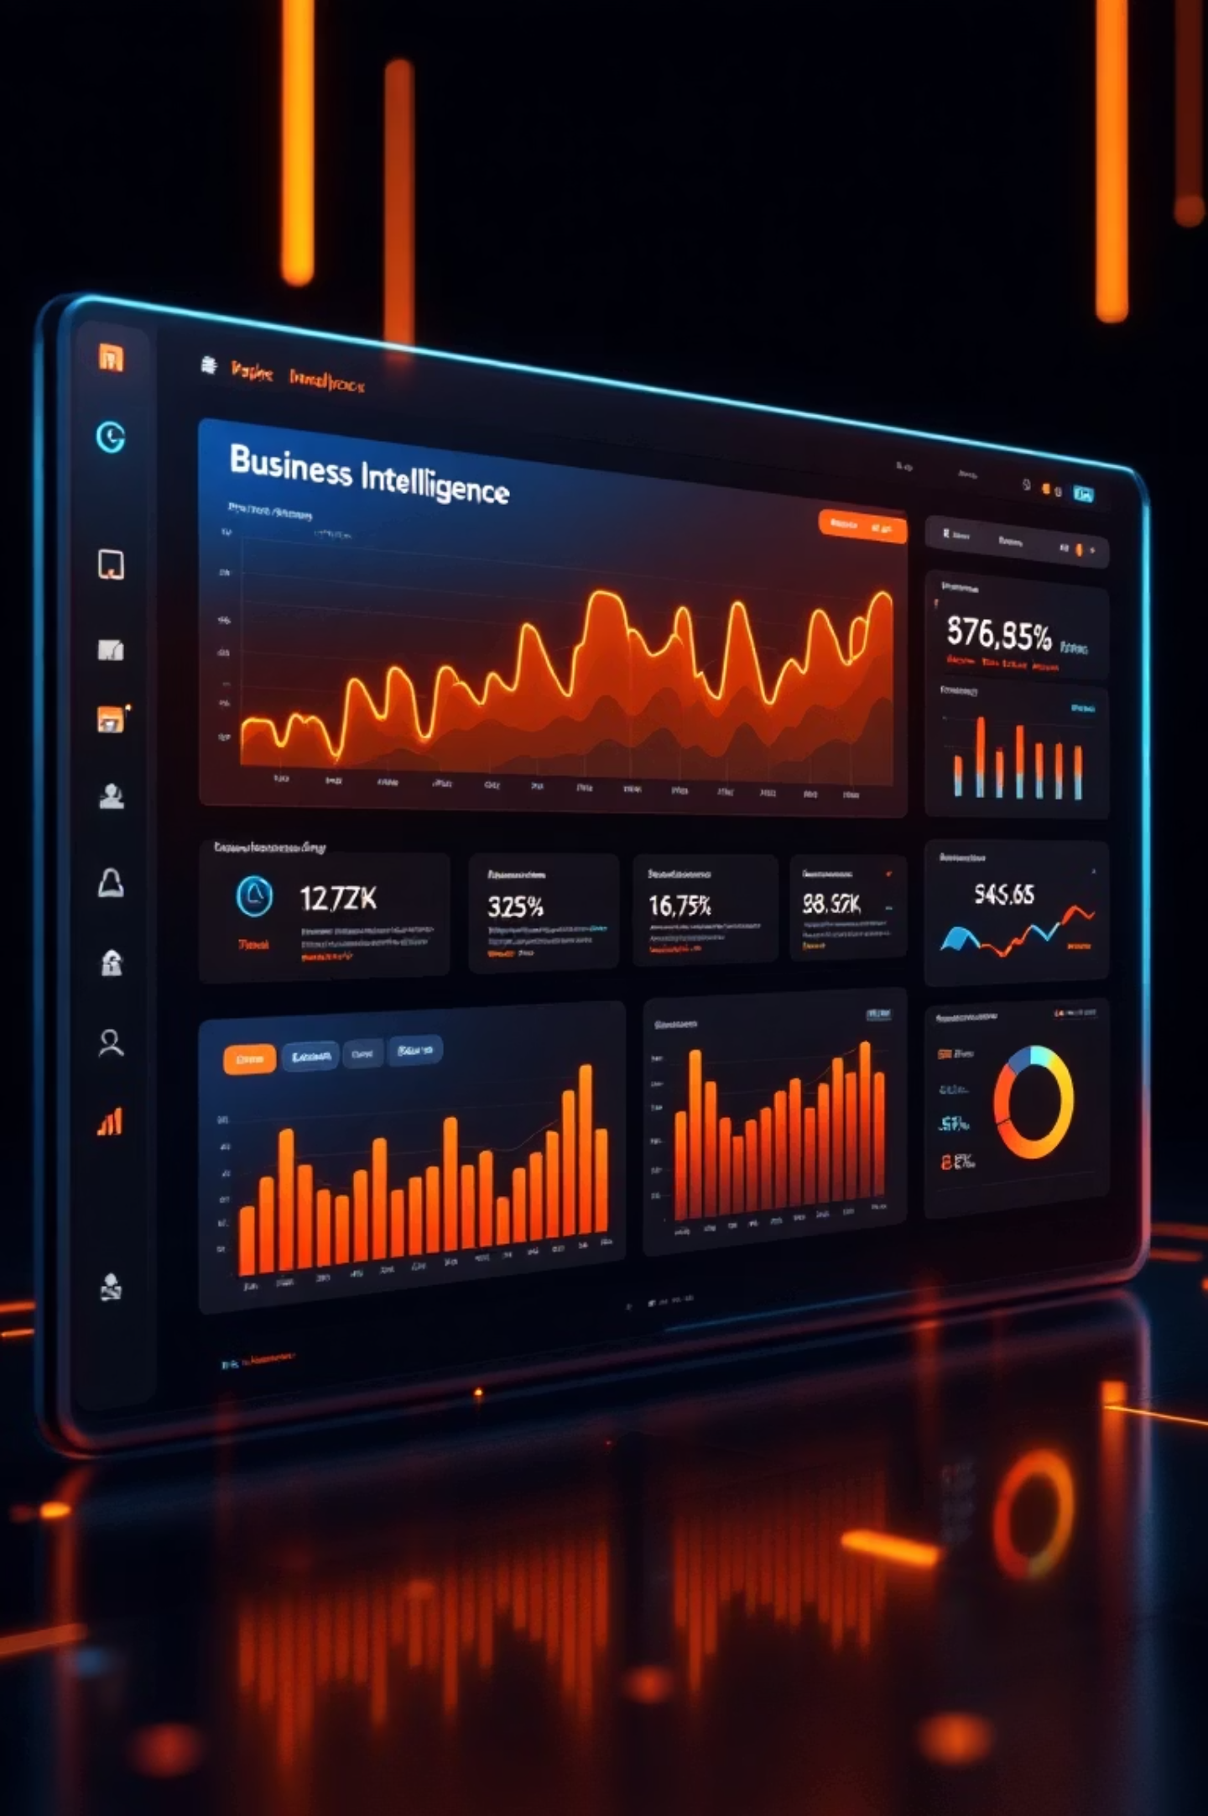
Power BI Dashboard Overview
KPI Cards
Total customers, average purchase amount, and review ratings displayed prominently
Visual Charts
Bar and donut charts show category revenue and subscription status
Drill-Down Analysis
Explore discount data by gender and age group interactively
Conditional Formatting
Highlights high and low values for quick interpretation

Slide 8
Customer Behavior Dashboard
3.9K
$59.76
3.76
Total Customers
Avg Purchase
Avg Rating
Revenue by Category
Subscription Status
Clothing leads at $104K, followed by Accessories at $74K and Footwear at $36K
27% of customers have active subscriptions, while 73% do not

Slide 9
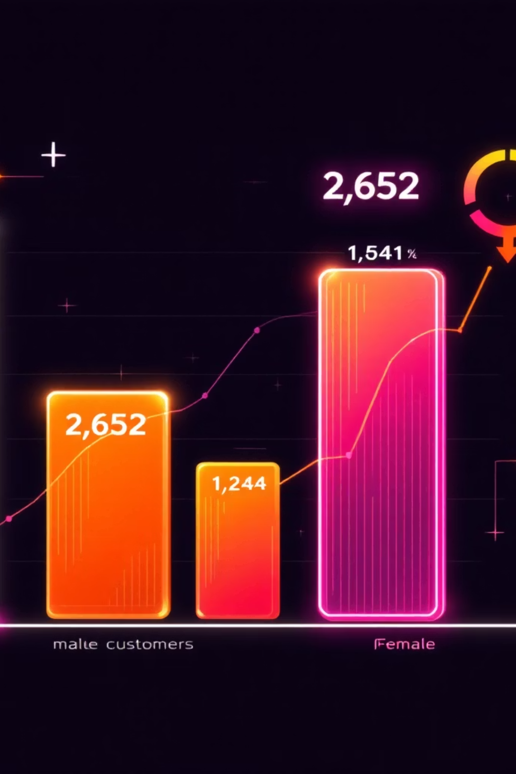
Discount Analysis by Demographics
Gender Breakdown
Age Group Insights
Male customers received 2,652 discounts compared to 1,248 for female customers
Young adults show highest discount application (1,028 total), with balanced distribution across other age groups

Slide 10

Key Takeaways
End-to-End Solution
Data Quality First
Seamless workflow from raw data to actionable insights using Pandas, SQL, and Power BI
Category-wise median imputation and validation checks ensured analysis accuracy
Interactive Insights
Interview-Ready
Drill-down capabilities and conditional formatting enable dynamic exploration
Demonstrates real-world analytics workflow suitable for professional discussions

